Slide 1

HR ANALYTICS
EMPLOYEE RETENTION

Slide 2

PROJECT NAME : HR ANALYTICS – EMPLOYEE RETENTION PROJECT MEMBERS: 1.SAGAR SONAR 2.VAISHNAVI PANSARE 3.RUTUJA 4.SHREYASH YENDHE 5.PRAVEEN SARANGI 6.SHIVA 7.BALA HARSHIT

Slide 3
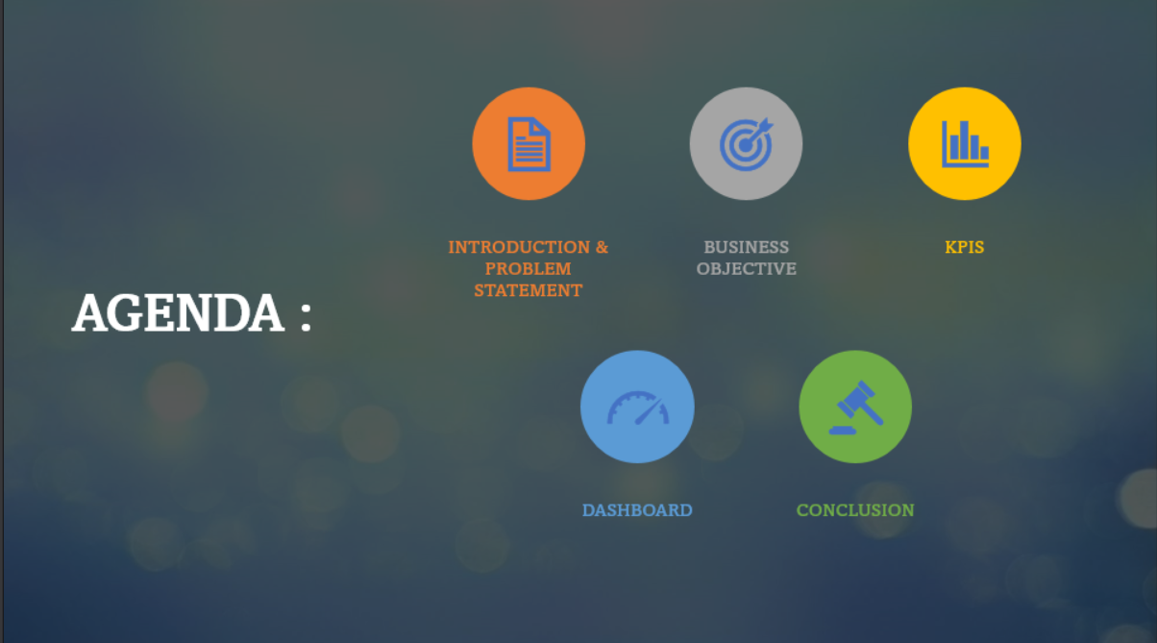

Slide 4
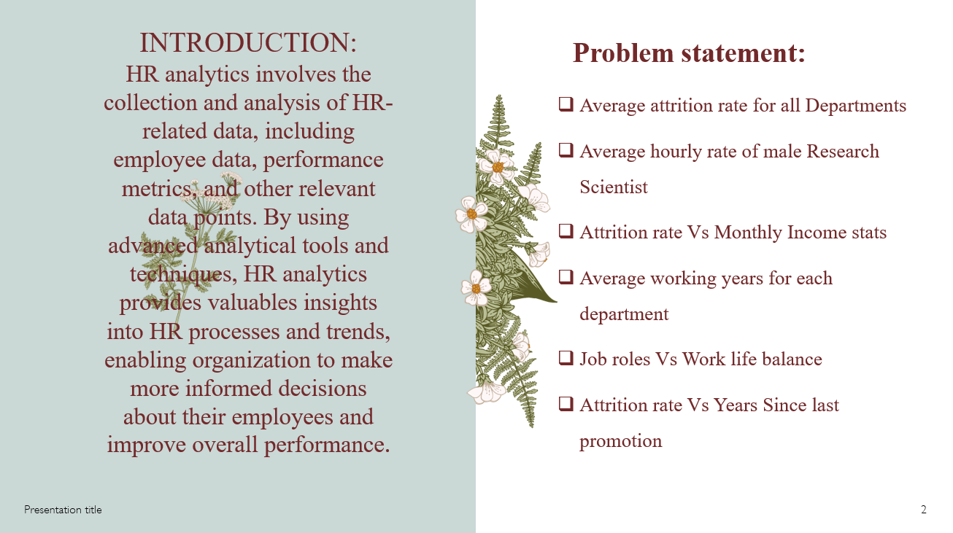

Slide 5
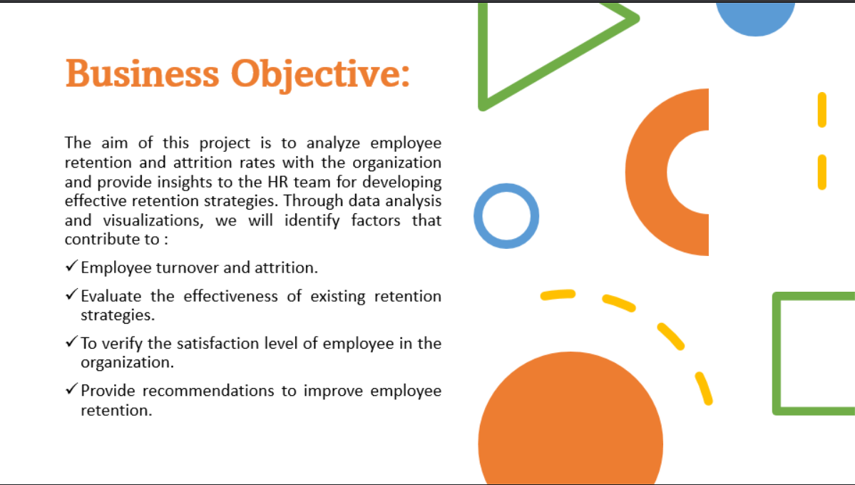

Slide 6
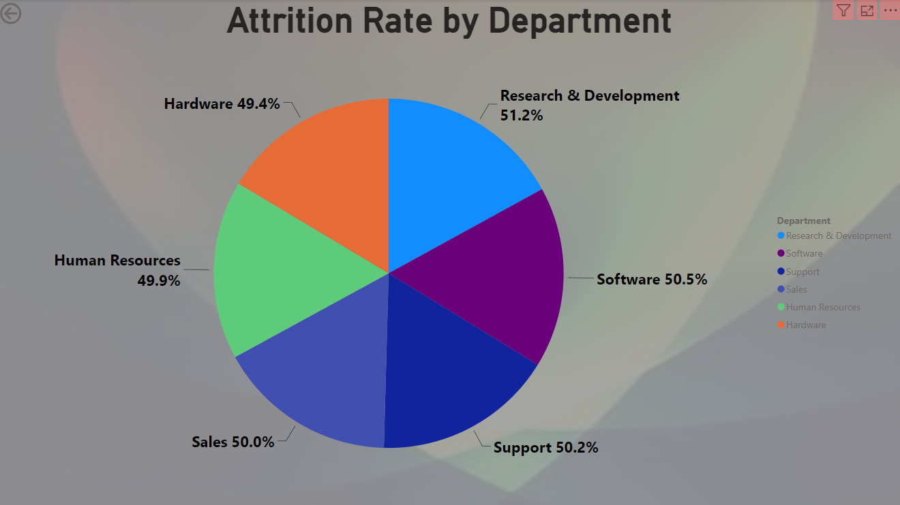
KPI 1 Average Attrition Rate For All Department
This KPI is to find out the relationship between each department and its attrition rate and here attrition rate is highest for Research & Development Department whereas lowest is for Hardware Department.

Slide 7
Insight from KPI 1
We can clearly say that attrition rate of employees for every department is almost 50% which indicates that attrition rate of employees does not depends on departments. So, irrespective of the department almost 50% of employees are leaving the company.
From this visualization we can concluded that we must make strong strategies to minimize attrition rate and improve our company’s Employee retention so that we can balance the company’s growth and right talent.

Slide 8
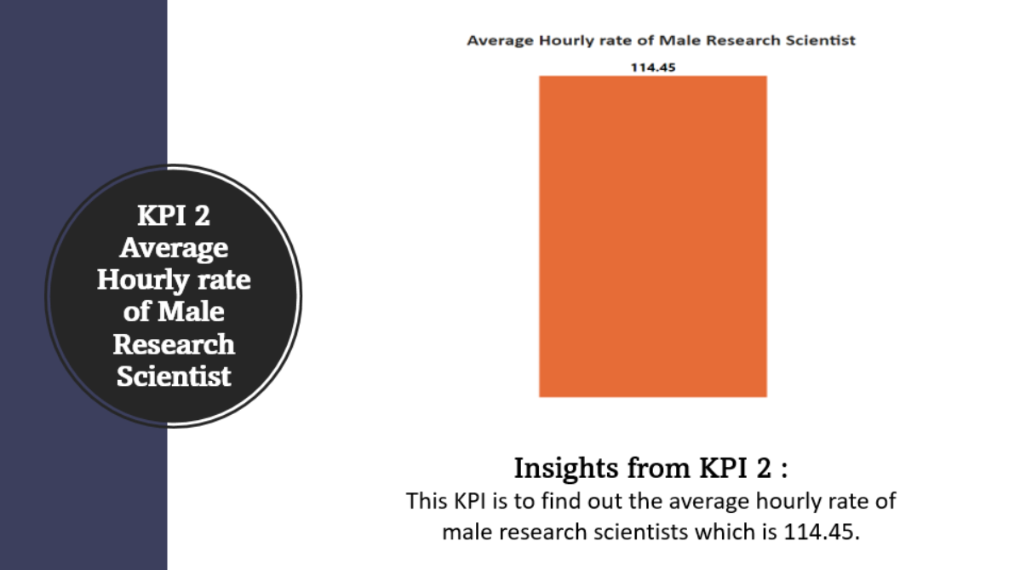

Slide 9
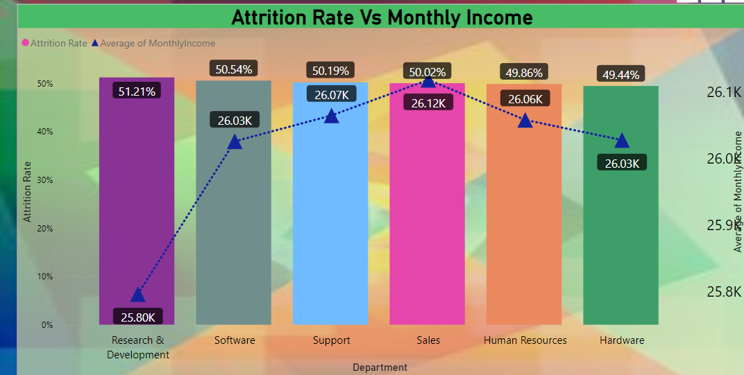
KPI 3 Attrition Rate Vs Monthly Income Stats
This KPI is about to fetch data for attrition rate vs monthly income stats.

Slide 10

Insight from KPI 3
Based on our analysis and visualization, it is evident that the Hardware Department has the lowest attrition rate of 49.44%, with an average monthly income of Rs. 26,091.20. On the other hand, the Research and Development Department has the highest attrition rate of 51.21%, with an average monthly income of Rs. 26,007.08

Slide 11

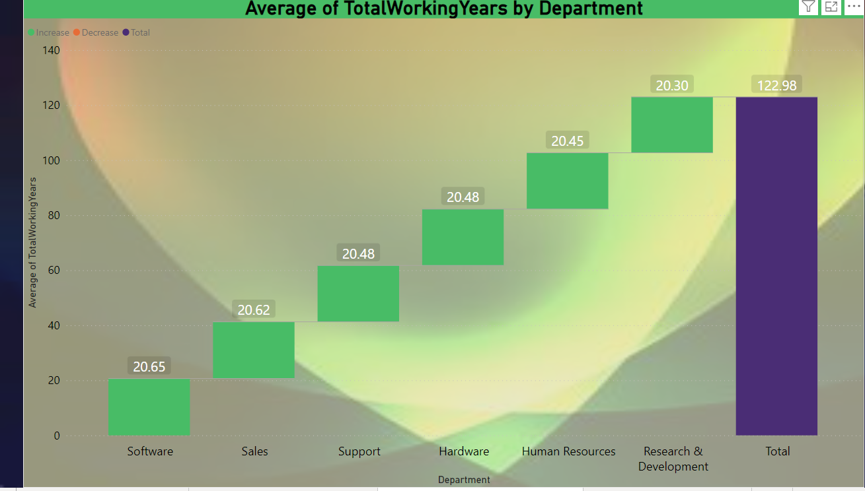
KPI 4 Average Working Years For Each Department
This KPI shows Average Working Years For Each Department.

Slide 12

Insight from KPI 4
From this we can see the average working years in software department is high as compared to the rest of the department and lowest is for research and Development Department.
From this we analyze and conclude that average working years is approximately 20 years for all Department.

Slide 13

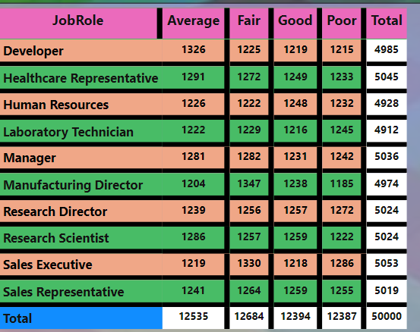
KPI 5.Job Role VS Work life Balance
This KPI is about Job Role VS Work life Balance for Total Employee.

Slide 14

Insight from KPI 5
From the analysis we conclude that
Developer and Human Resource has poor work life balance
Laboratory Technician and Manufacturing Directors has average work life balance.
Research Scientist and Research Director has fair work life balance
Manager and Sales Representative and Sales Executive has good work life balance

Slide 15

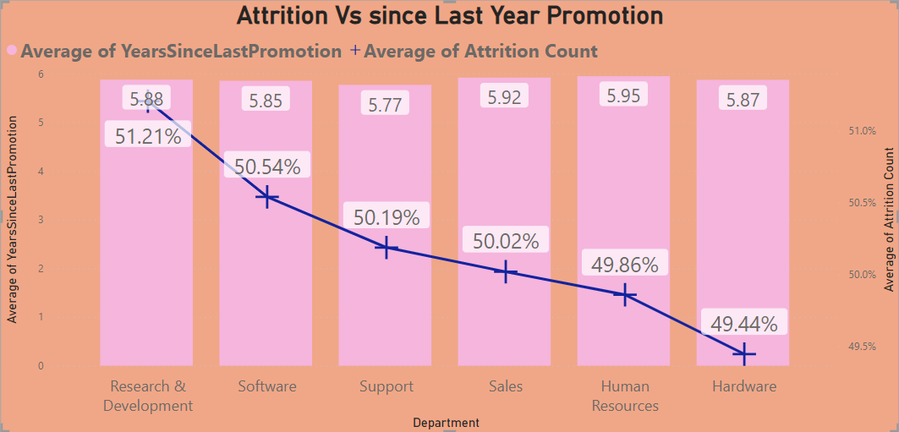
KPI 6. Attrition Rate VS Last Year Promotion
This KPI shows attrition rate vs since last year promotion.

Slide 16

Insight From KPI 6.
From KPI 6 we can conclude that attrition rate for Research and Development is compared to other Department .
Human Resource and Sales Representative of avg since last year promotion is higher as compared to other department

Slide 17

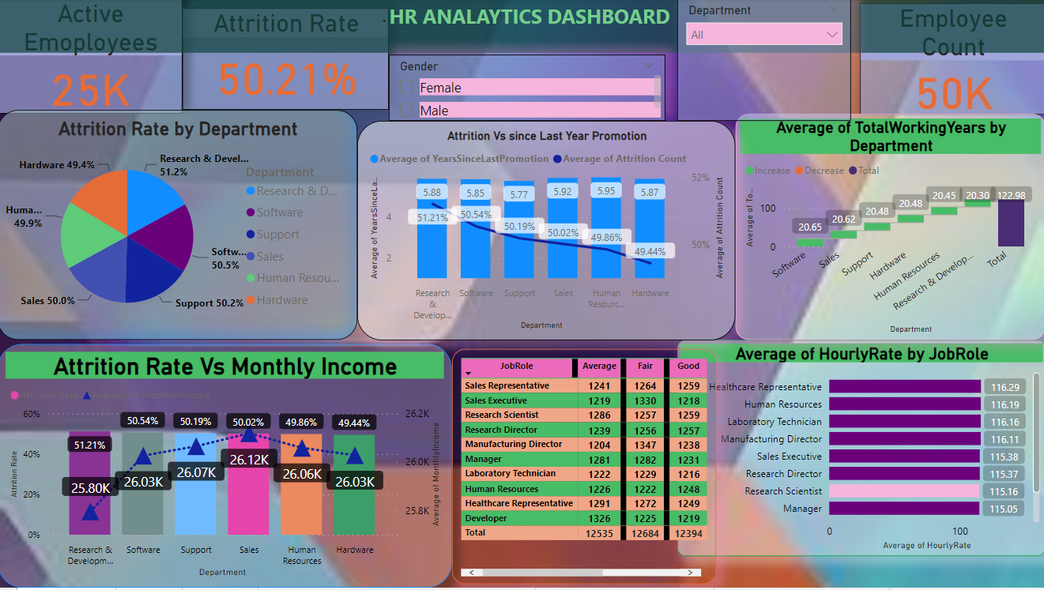
DASHBOARD

Slide 18
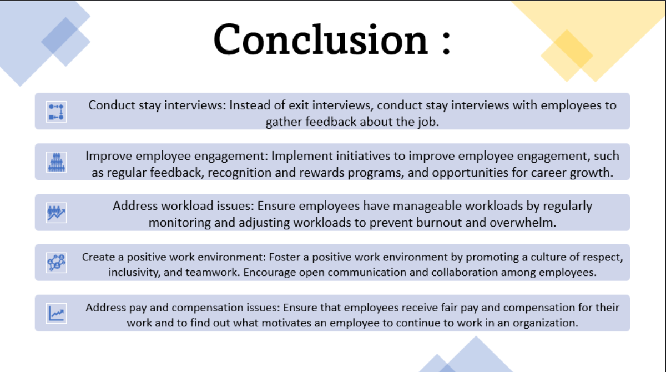

Slide 19


